Slide 1

CS377E | Spring 2023
Claire Muscat
Christina Kwak
Grace Zhang
Nathan Marks
An education expert in your pocket

Slide 2

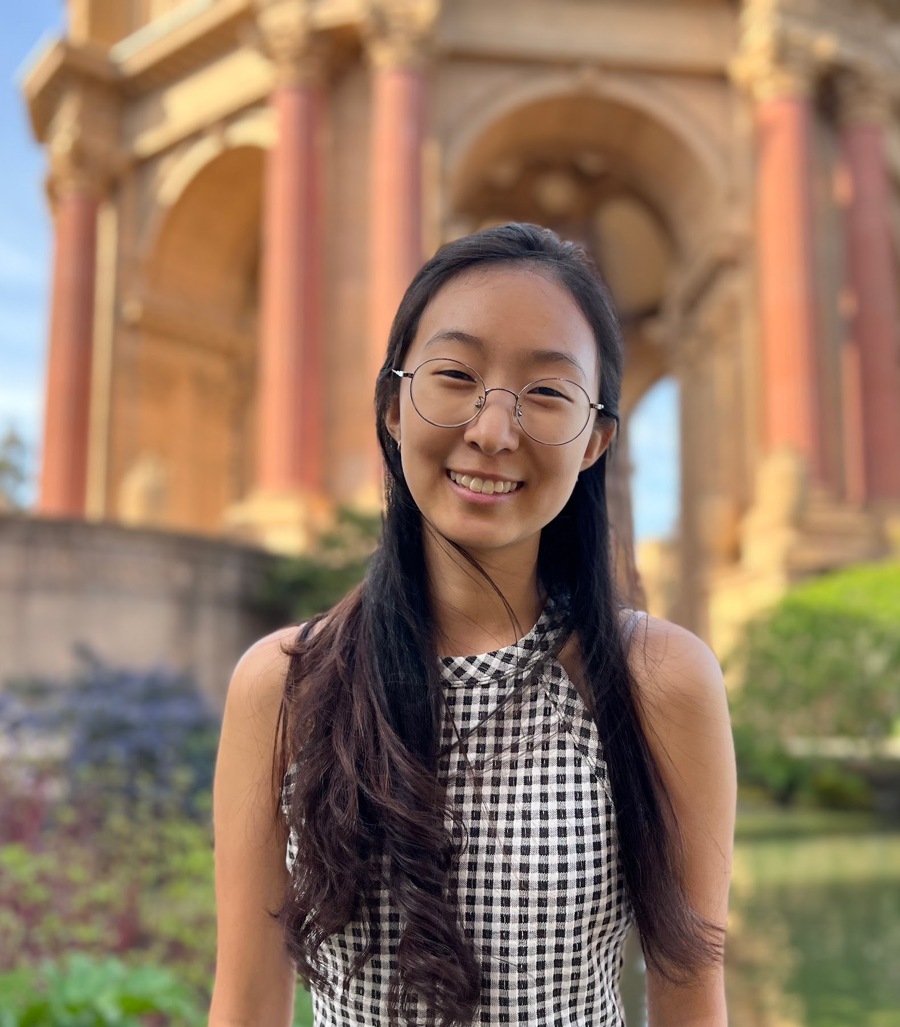
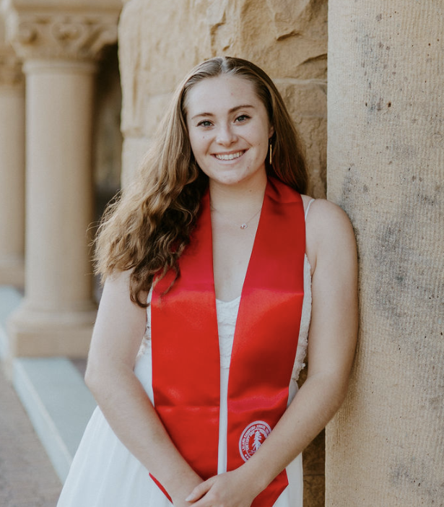
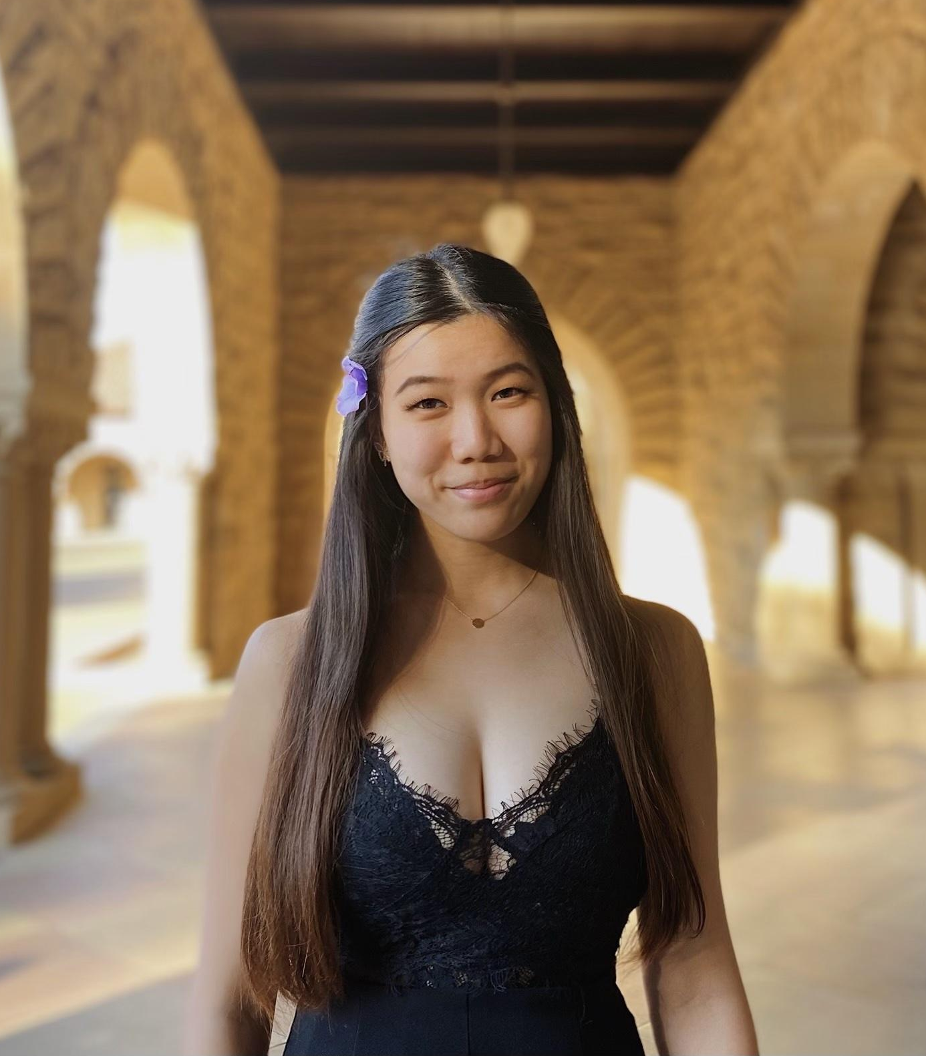
Our Team
Nathan Marks
Christina Kwak
Claire Muscat
Grace Zhang
CS, AI Coterm
Econ, HCI Coterm
CS, HCI Coterm
CS, HCI Coterm

Slide 3



Meet Angela

Slide 4
Meet Angela
“For every [homeschooling] parent, it’s intimidating — no one ever feels competent and secure like they’re doing a great job…”

Slide 5

Problem
Differing resources and parental experience lead to unequal outcomes in homeschooling.

Slide 6

Problem
Differing resources and parental experience lead to unequal outcomes in homeschooling.
Solution
We provide resources for homeschooling parents to be better equipped and empowered in their teaching.

Slide 7
An education expert in your pocket
Notes:
Should is say more here?

Slide 8
Design Evolution

Slide 9
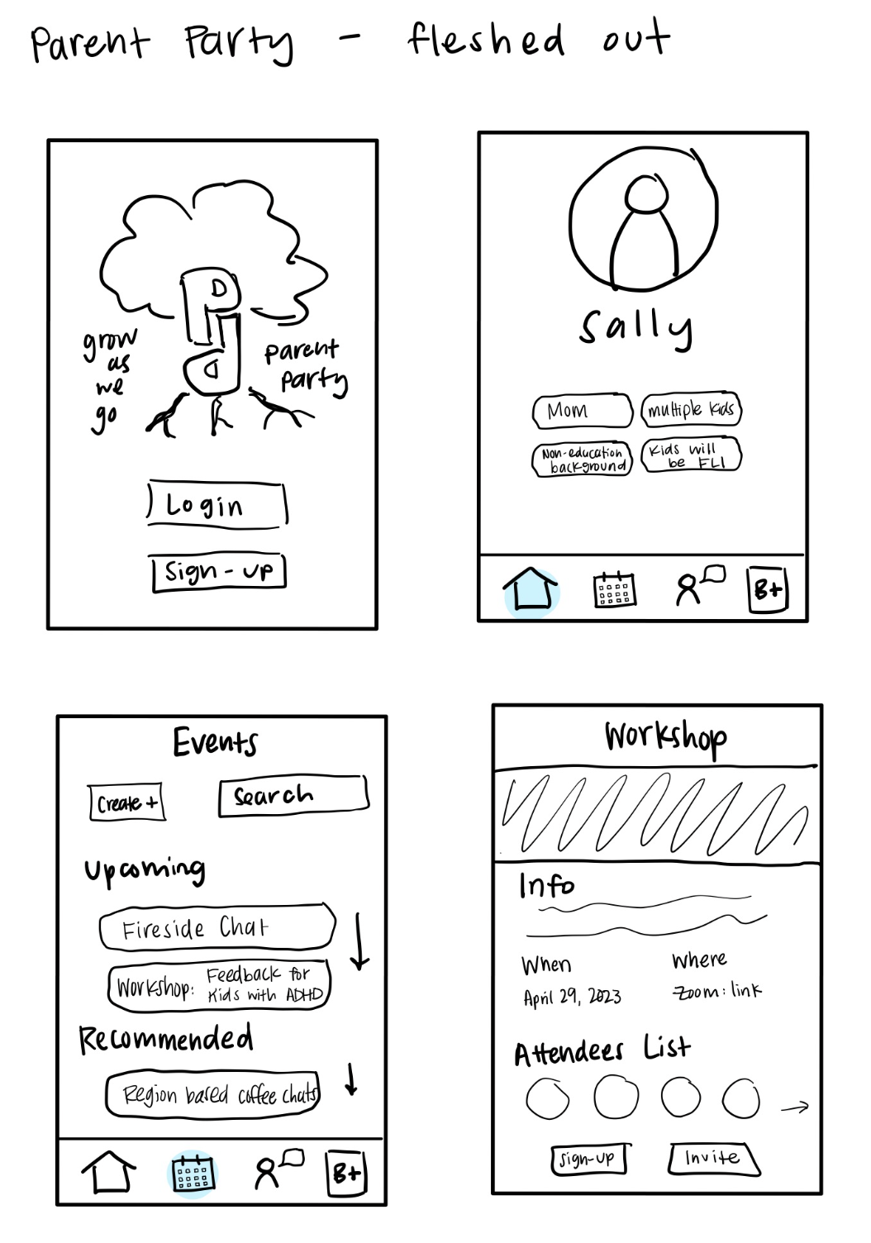
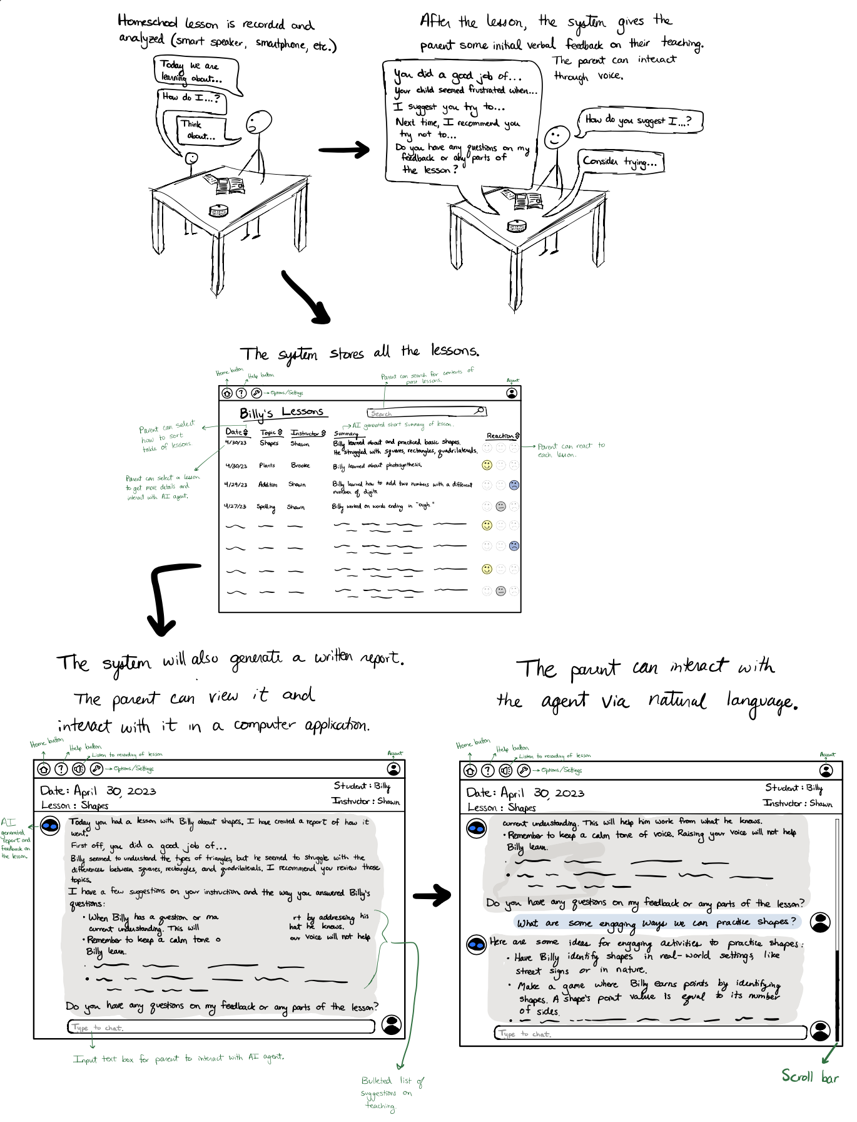
Storyboards
and
Ideation
Feedback workshop platform & forum for parents
AI lesson recorder & post-lesson feedback generation
Notes:
Went thru a lot of ideas, lot of modalities
Ultimately decided:
Reason for mobile app: recording and reports on the go is probably a big one, easily accessible and low friction
for quote: “[As a homeschooling parent, your] life is very integrated. It’s go go go.” – P1

Slide 10
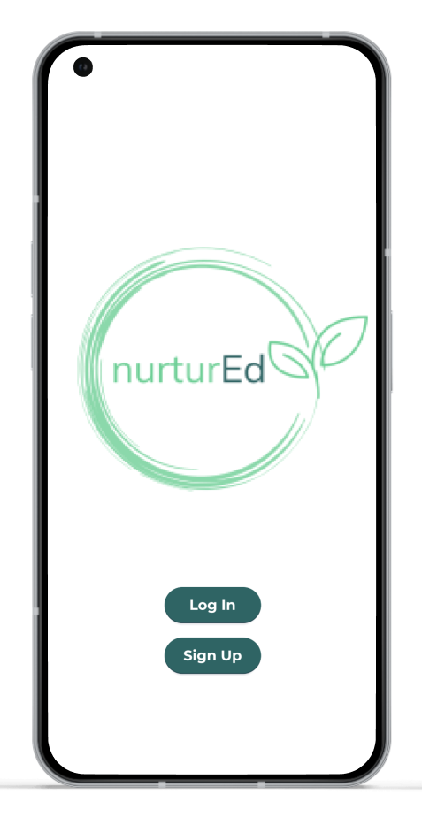

Mobile App
“[As a homeschooling parent, your] life is very integrated. It’s go, go, go.”
Notes:
Ultimately decided:
Reason for mobile app: recording and reports on the go is probably a big one, easily accessible and low friction

Slide 11
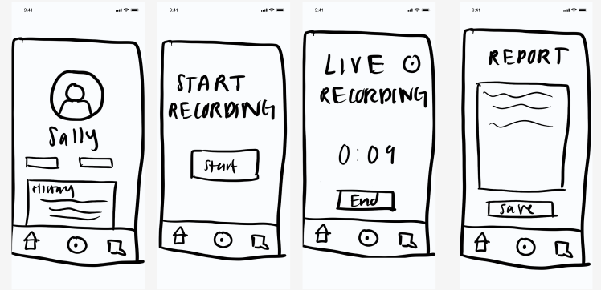
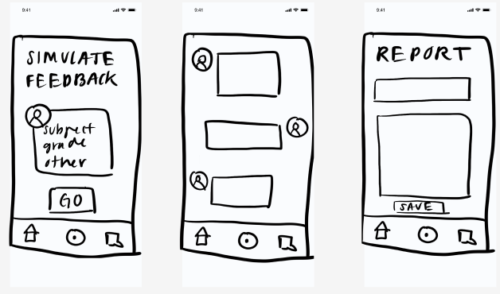
Low-fi Prototype
Insights
Time is a key resource
AI is non-judgemental
Proxy for Teacher-Ed programs

Slide 12





Features
Tip of the Day
Lesson Recording
Lesson Report
AI Assistant

Slide 13



Med-fi Iteration Themes
1
2
3
How do we make intuitive functionality?
How do we ensure that we keep an encouraging tone?
How do we optimize information presentation?

Slide 14
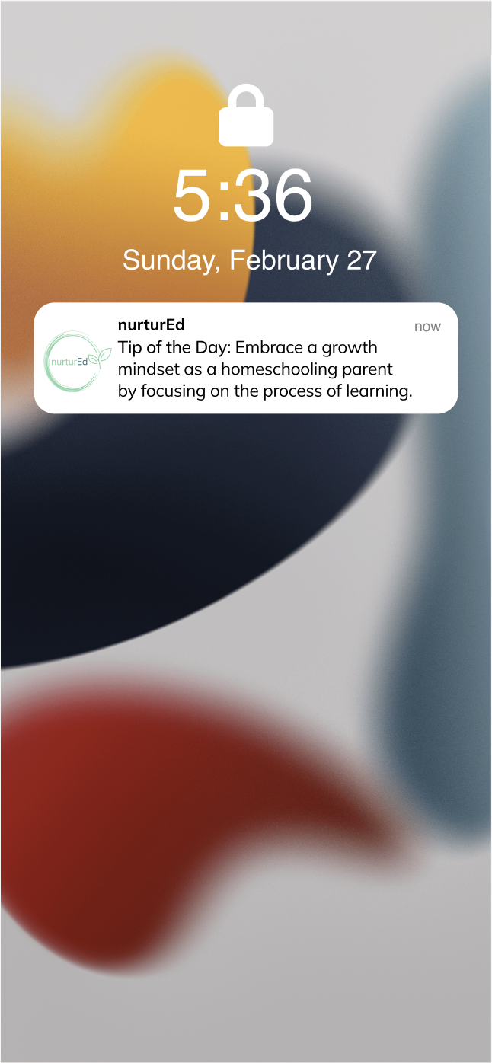
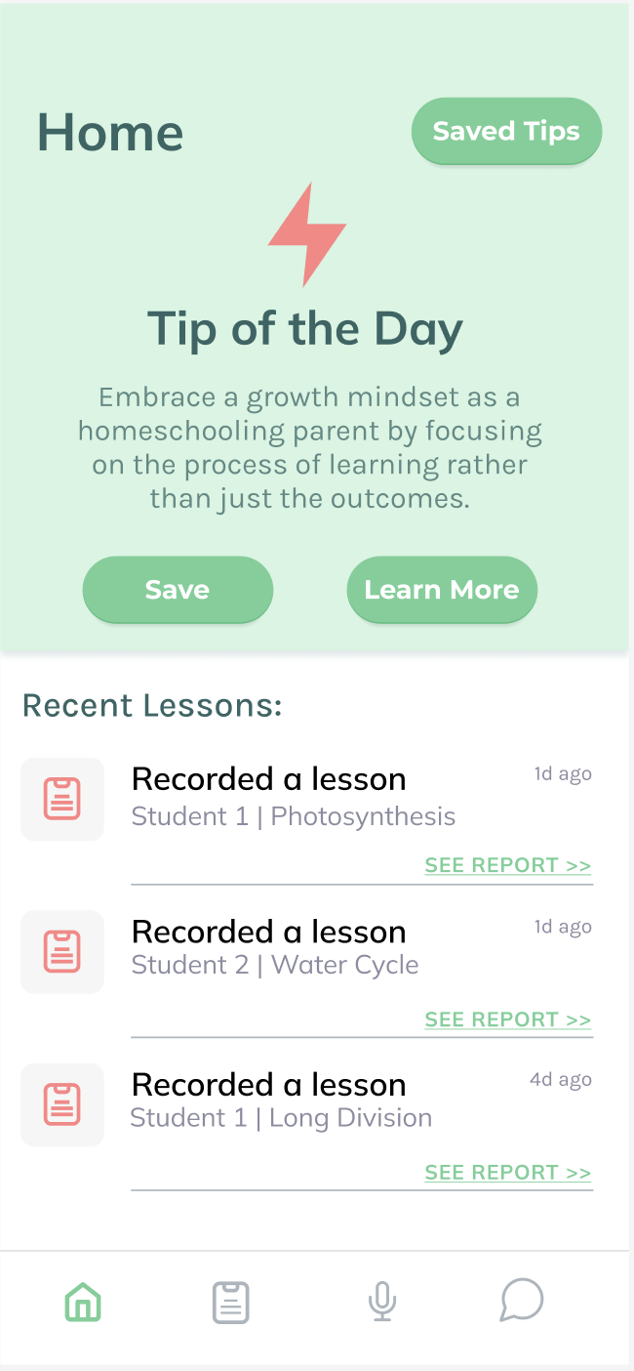
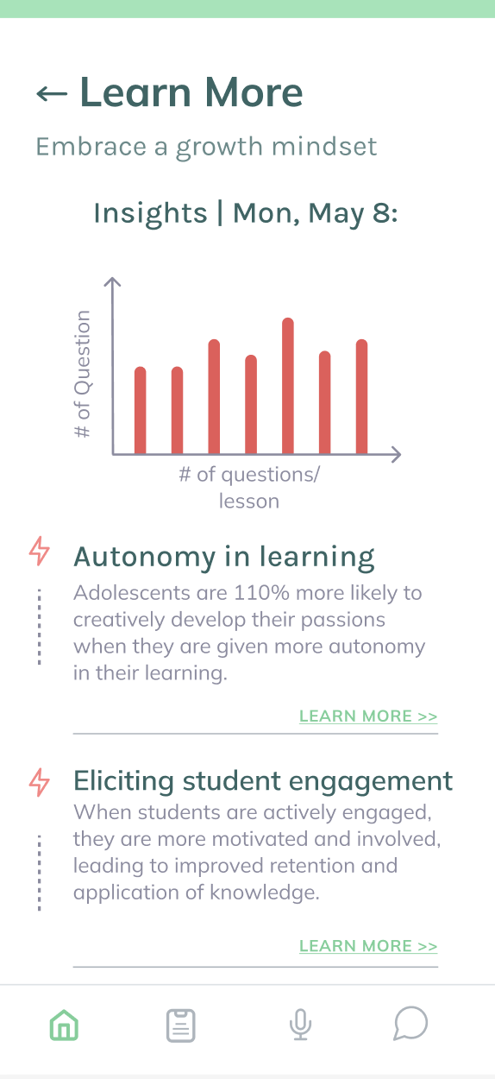
Tip of the day
Encouraging tone & resources

Slide 15
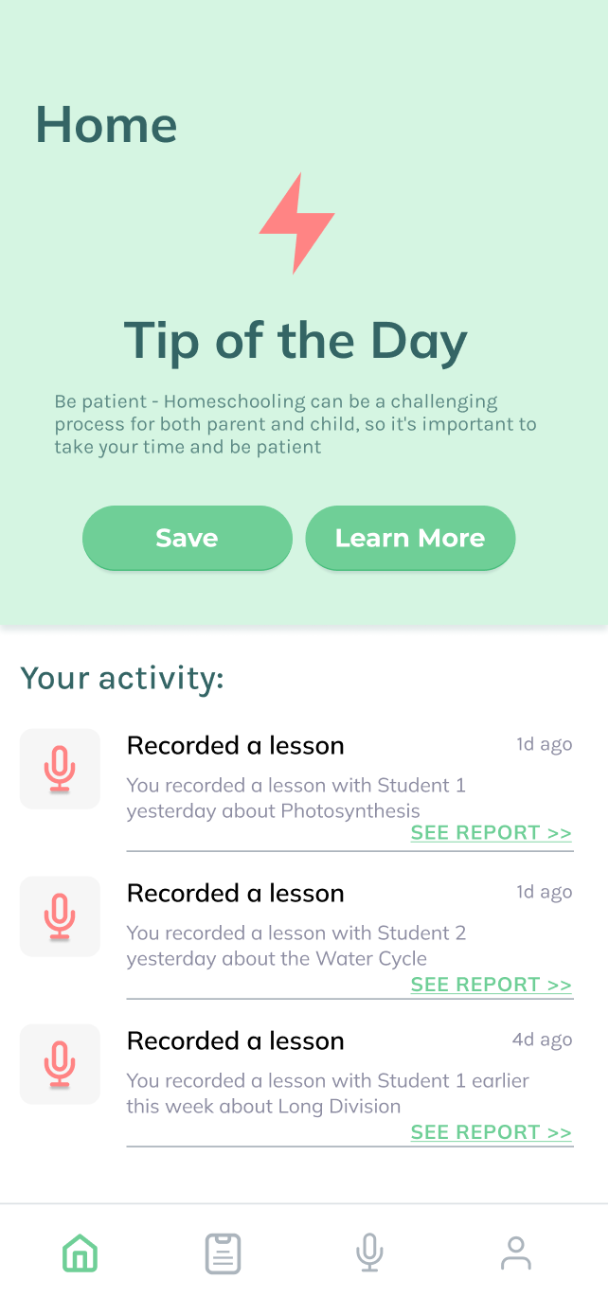
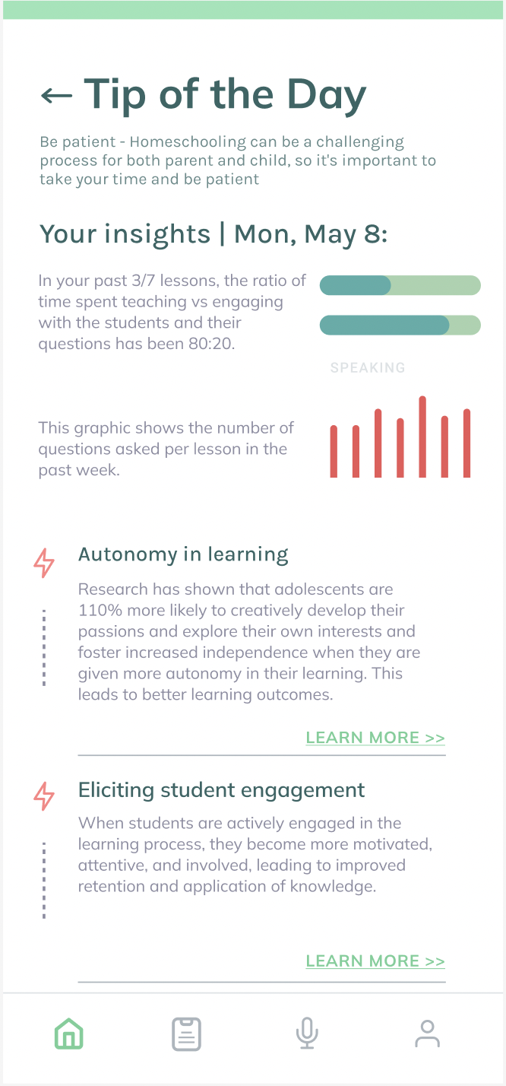
Changes | Tip of the Day
Improved information presentation

Slide 16
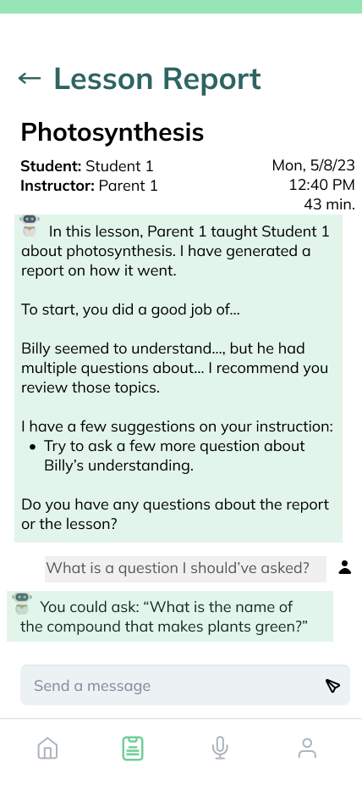
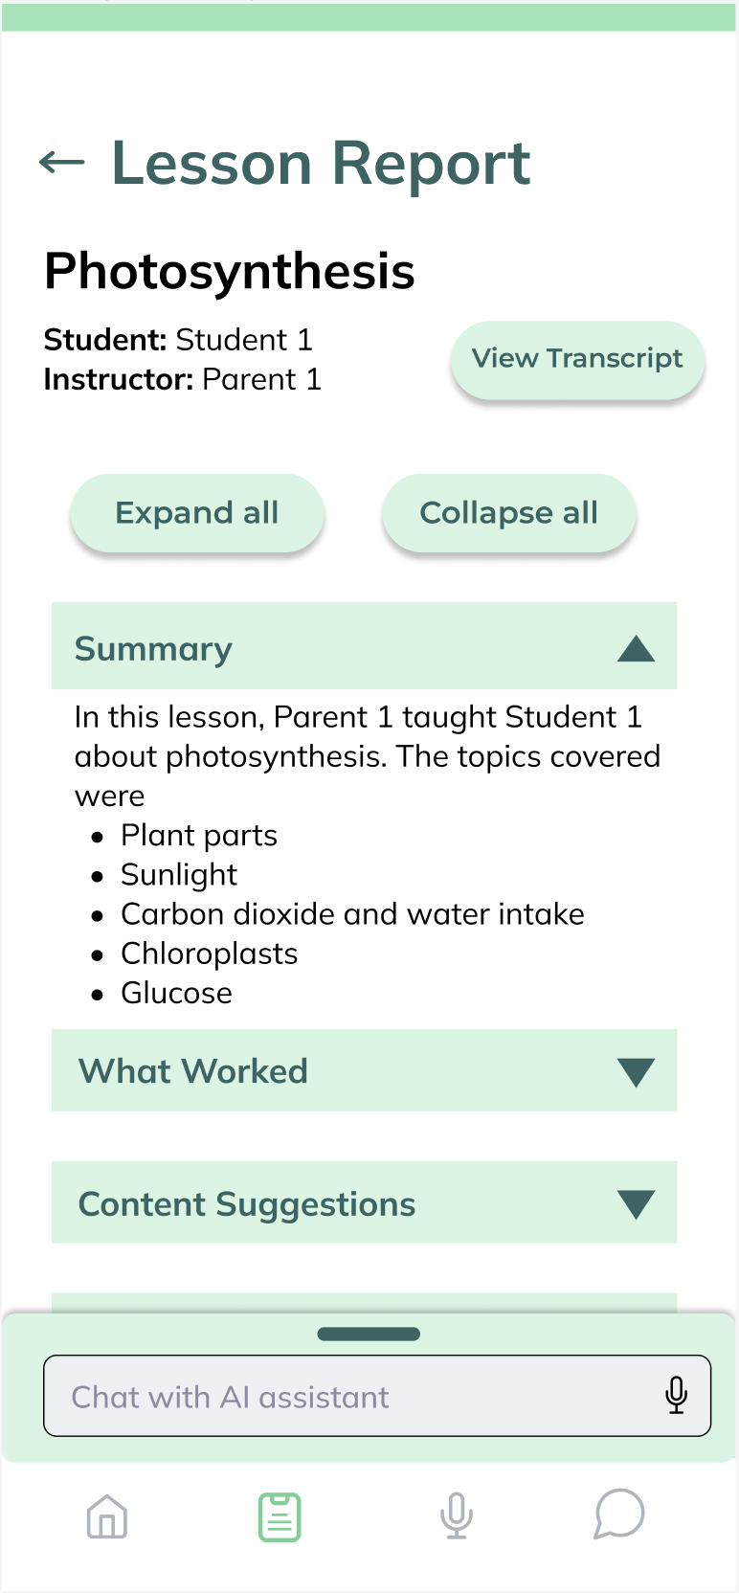
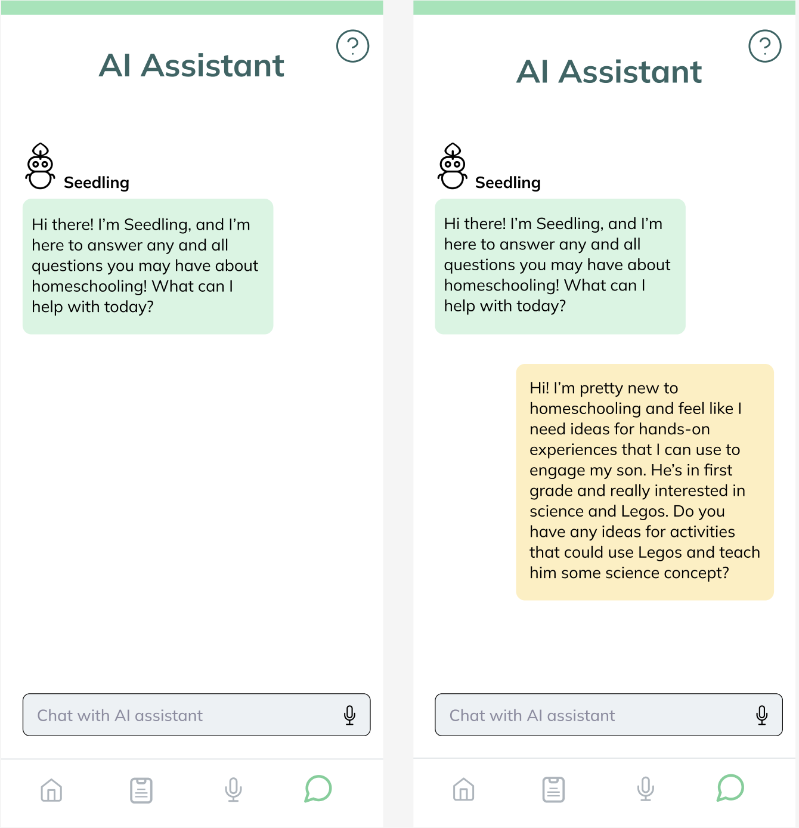
Changes | Reports + AI Assistant
Improved information hierarchy
and simpler functionality

Slide 17
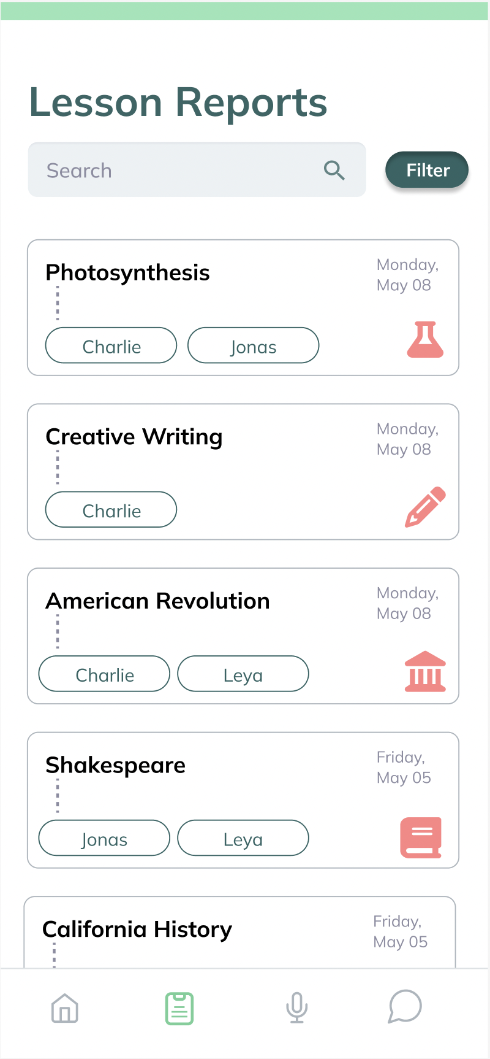
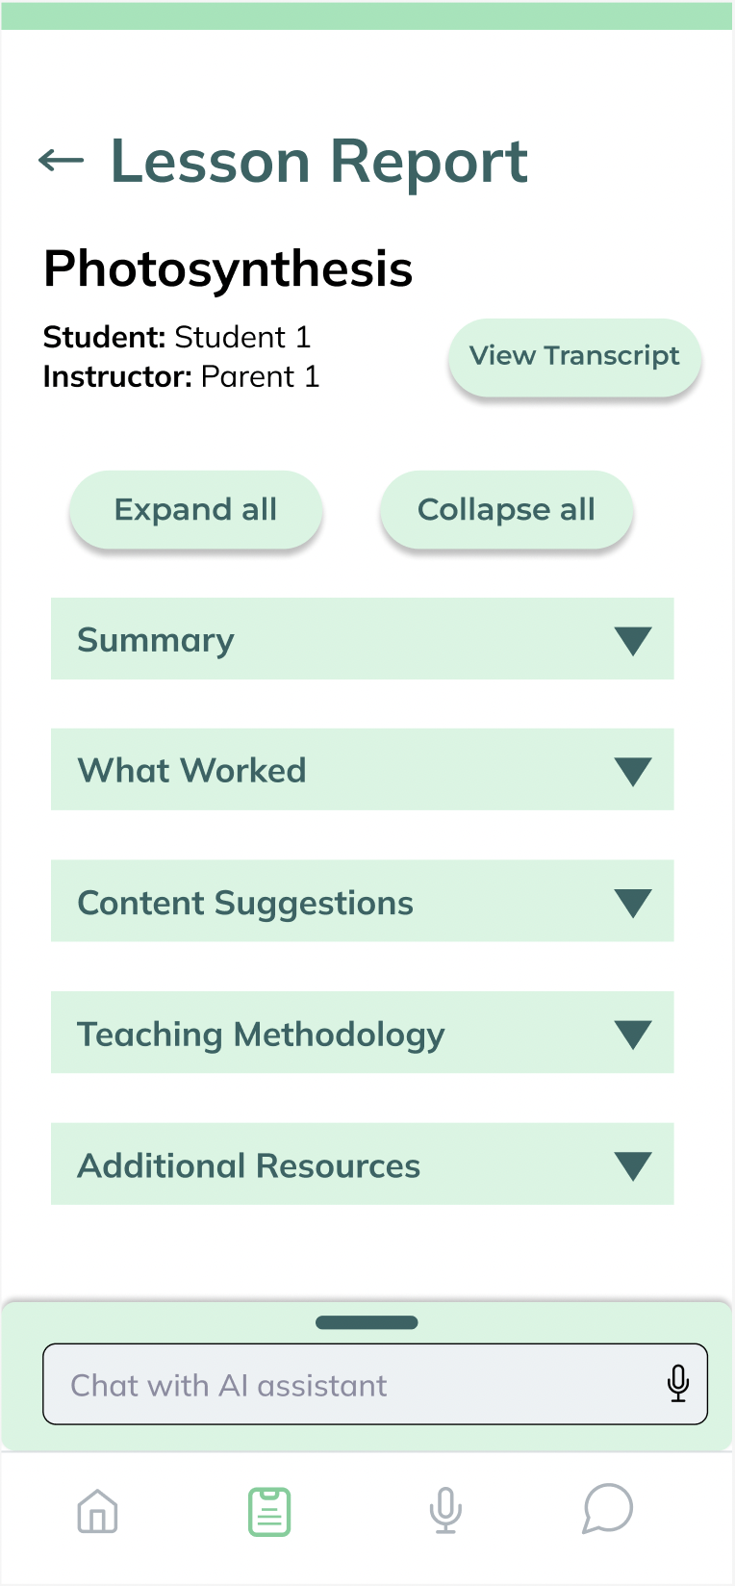

Lesson report
“I do like that there are bullet points [in summary].”
Information hierarchy

Slide 18
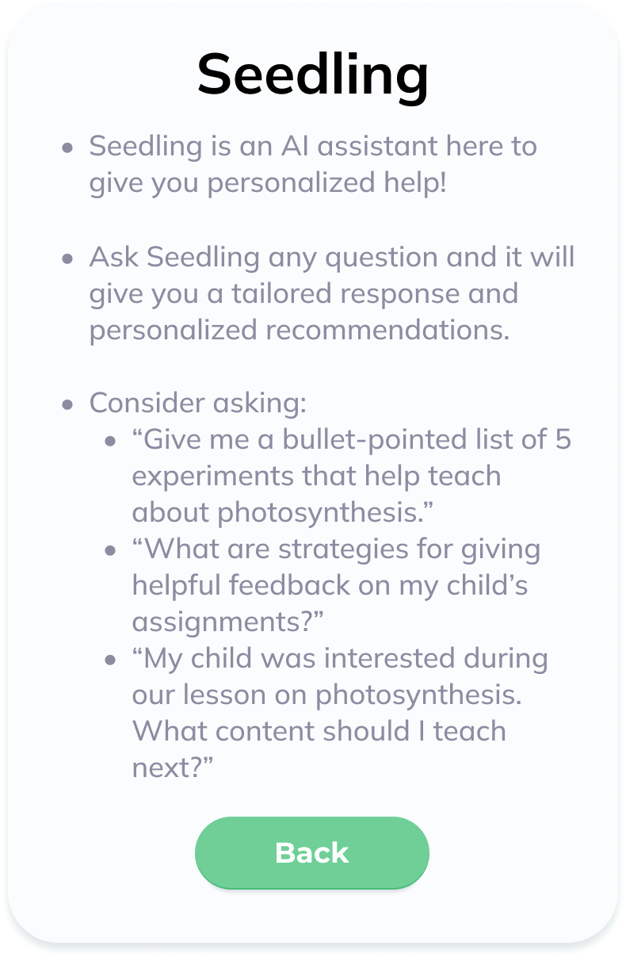
AI Assistant
“You’re providing parents with the kind of expertise they would get when sitting down with an education expert.”
Information presentation

Slide 19
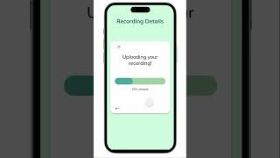
Notes:
We’ll hop into a demo of our project focusing on the lesson recording and report functionality.
Once receiving a notification with the tip of the day, we can click on it and be taken to the app’s homepage.
From here, we can click on the microphone icon in the navigation bar.
The text here explains how to use this feature as well as provides information data privacy and security information.
To begin recording, we click on this button.
While giving the lesson, we can pause at any time.
And once the lesson is complete, we can hit the stop button.
From here, we can edit the transcript. We can scroll through the transcript and have the ability to remove any sensitive information before upload and analysis or edit any faulty transcription that may have occurred.
We can then finish and add details about the recording such as the lesson title, the subject, and the names of the students to whom the lesson was taught.
We can then upload the transcript where it is analyzed by AI to produce a report full of personalized feedback about the lesson.
We see a list of AI-generated lesson reports. We are also able to filter this list by subject or student.
Clicking on a specific lesson allows us to view a personalized report giving us feedback on how the lesson went and what could be improved going forward.
Lastly, we can also interact with Seedling our AI-assistant who is able to answer questions and provide additional feedback.

Slide 20
Next Steps
1
2
3
Implement AI functionality
Continued user testing
Secure partnerships
Notes:
Going forward we have three main goals:
First we plan to implement the backend and bring the AI functionality to life
Second we plan to continue iterative development via more user testing with homeschooling parents
Lastly, we plan to work on securing partnerships with various stakeholders such as homeschooling co-ops and curriculum creators

Slide 21
Mission
Empowerment and confidence through personalized feedback and AI assistance

Slide 22
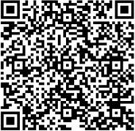
Check out our prototype!
Thank you!
Questions?
Nathan Marks
Christina Kwak
Claire Muscat
Grace Zhang
Empowerment and confidence through personalized feedback and AI assistance
CS,
AI Coterm
Econ,
HCI Coterm
CS,
HCI Coterm
CS,
HCI Coterm

Slide 23
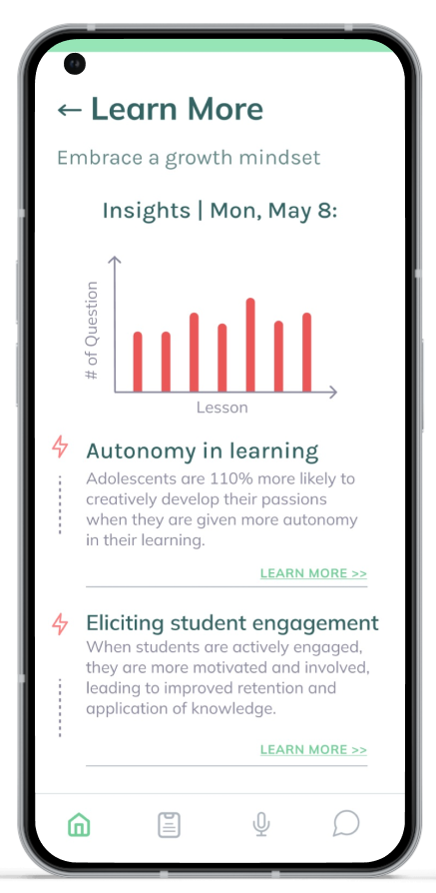
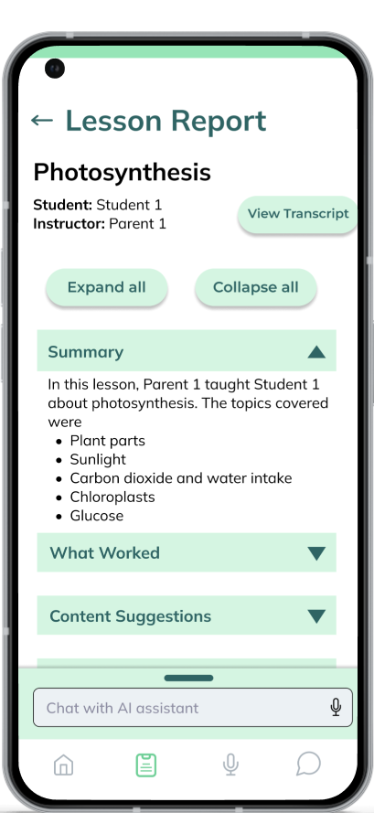
Check out nurturEd!
Thank you!
Questions?
Nathan Marks
Christina Kwak
Claire Muscat
Grace Zhang
CS,
AI Coterm
Econ,
HCI Coterm
CS,
HCI Coterm
CS,
HCI Coterm
An education expert in your pocket
Notes:
Thank you so much for listening, and we’d be glad to take a couple of questions.

Slide 24

Check out our prototype!
Thank you!
Questions?
Nathan Marks
Christina Kwak
Claire Muscat
Grace Zhang
CS,
AI Coterm
Econ,
HCI Coterm
CS,
HCI Coterm
CS,
HCI Coterm
An education expert in your pocket

Slide 25
Ok
What is a co-term. I’d still introduce yourselves
Good story
remove “all students deserve a quality education” I think everyone agrees. ***
Slow down on this important SLIDE ****
Ok
Read those captions to give us an idea of what was there **
Ok – mention homeschooling more
Mention homeschooling
ok
Pick top 3 of these 4 and cut some text so doesn’t wrap
Images too small to follow. Can you focus on the one key change you talked about and only show that????
Less bullets. Do we need all of this?
Above
Animate in and point to or animate oval on whatever you are talking about at each point on this slide. All too small. Two slides????
Above
Can we cut some text. Maybe just the highlight titles are enough
Make clearer what you are talking about. Animate red circles and screens in
Above
Slower on this slide
Animate in each screen as you talk about them
Feels like way too much. Are there 3 or 4 screens at most you can focus on and animate in as you talk about it
This looks good and I add red circles and animate in as you talk about it so I know what you are talking about
Good. Make sure seedling is what you invented (say that). Animate in these
Demo: what is a lesson? Wasn’t really clear from earlier give a better overview of the idea early on
This should probably be your last slide (add names and QR code of your project in white space at bottom left).
I’d put this before 24
I would build this into what you say first on 24 without have the bullets.
Integrate this in earlier

Slide 26
Mission
Empowerment and confidence through personalized feedback and AI assistance
Education expert in your pocket

Slide 27
Summary
Key Innovation: Currently no consolidated platform for homeschool parents
Notes:
In summary there are currently no consolidated platforms supporting homeschooling parents.
To meet this need we created nurtured

Slide 28
Summary
Key Impact: Levels playing field of homeschooling and learning outcomes
Key Innovation: Currently no consolidated platform for homeschool parents

Slide 29
Summary
Long-term Impact: Improving teaching for all
Key Impact: Levels playing field of homeschooling and learning outcomes
Key Innovation: Currently no consolidated platform for homeschool parents
Notes:
In summary there are currently no consolidated platforms supporting homeschooling parents.
To meet this need we created nurturEd with the goal of leveling the playing field of homeschooling and learning outcomes.
Long-term, we believe that nurturEd’s empowerment of homeschooling parents will improve teaching for all so that no student is left behind.

Slide 30

Tasks
Save the “Tip of the Day,” explore it in more detail, and navigate to saved tips
Record and upload a live lesson
Find a lesson report and engage with the recommendations

Slide 31
Summary
Key Innovation: currently no consolidated platform for homeschool parents
One-step system for accessible coaching, feedback, resources, growth
Key Impact: levels playing field of homeschooling and learning outcomes
Gives access to critical feedback to homeschooling parents
Long-term Impact: improving teaching overall
Homeschooled students have better learning outcomes

Slide 32

Next Steps
High-fidelity prototype
Implement AI functionality
Continued user testing
Find partnerships
Co-ops
Charter schools
Curriculum creators
Homeschooling conventions

Slide 33
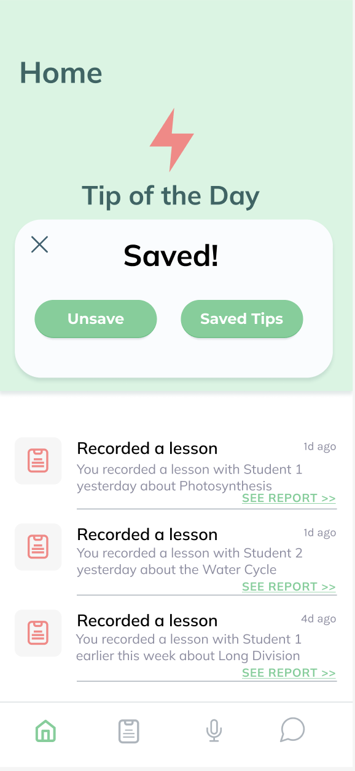
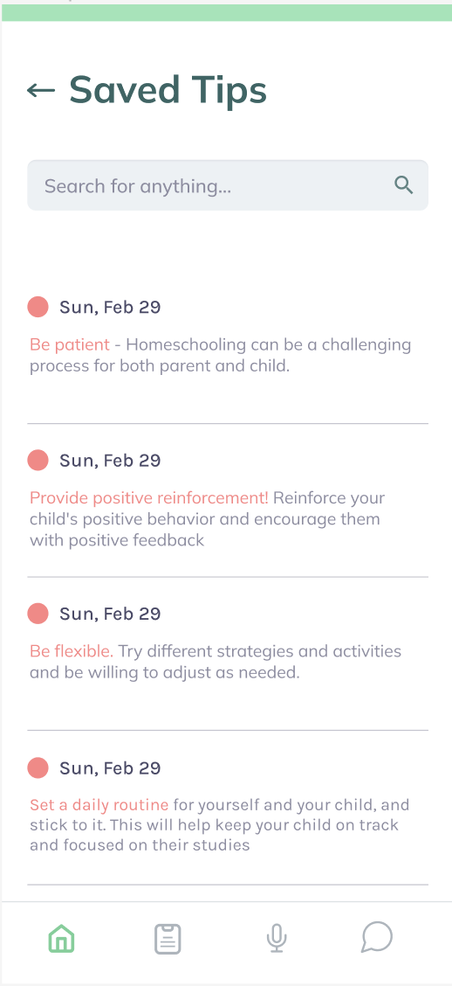
tip of the day
“I want to learn more about the tip of day”

Slide 34
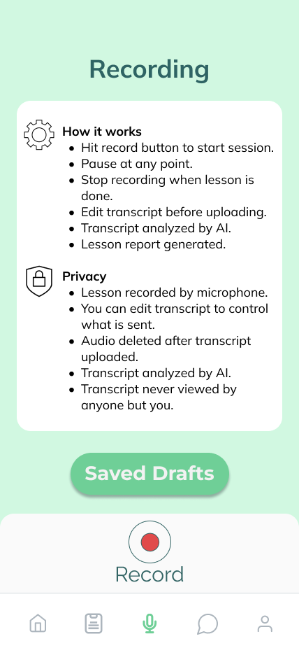
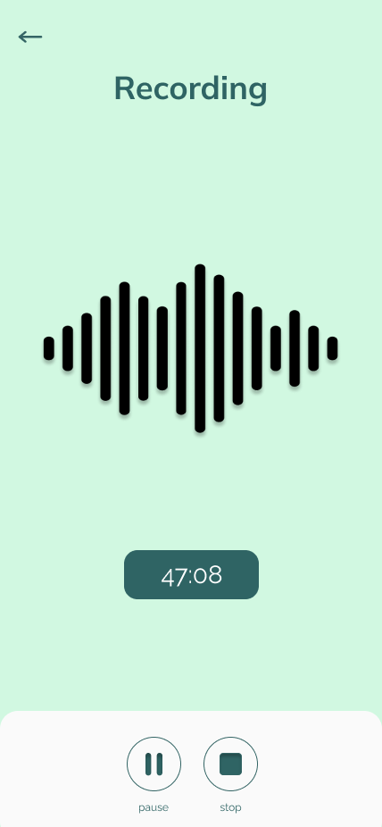
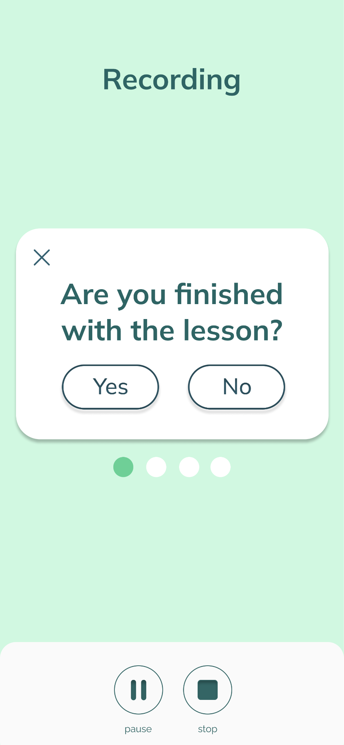
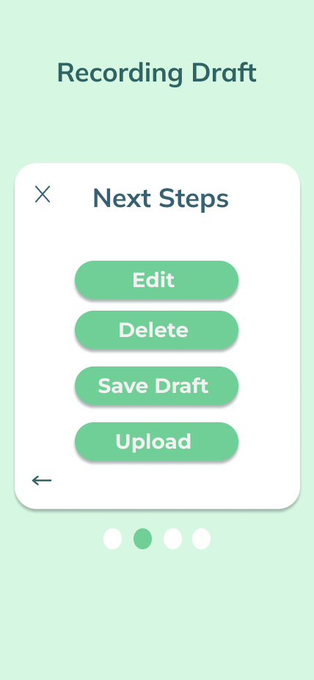
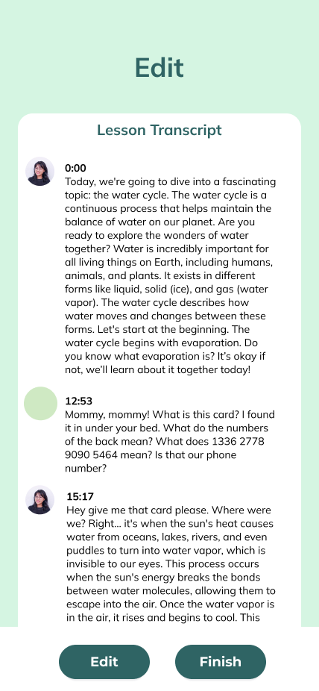
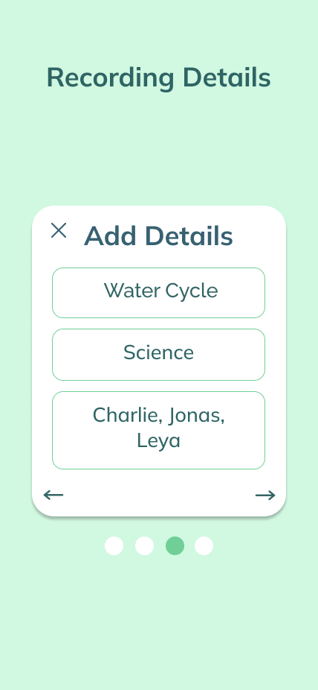
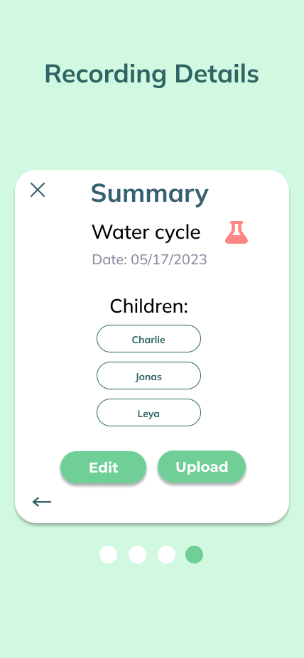
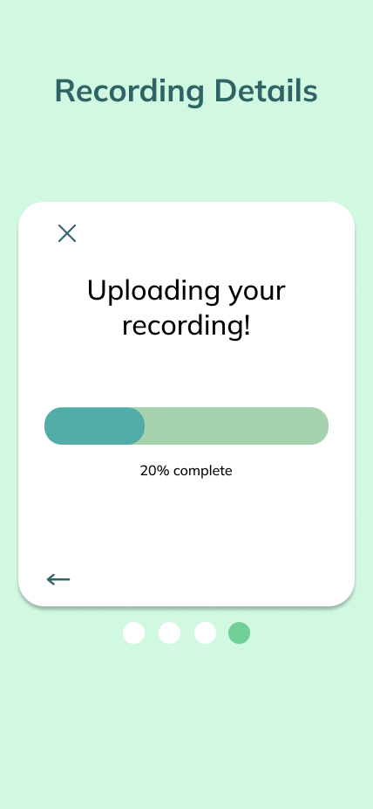
record lesson
“What is someone yells some private information in the middle of the recording, like a credit card number”

Slide 35
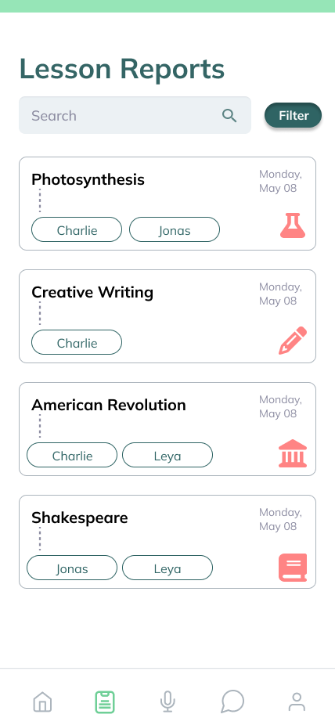
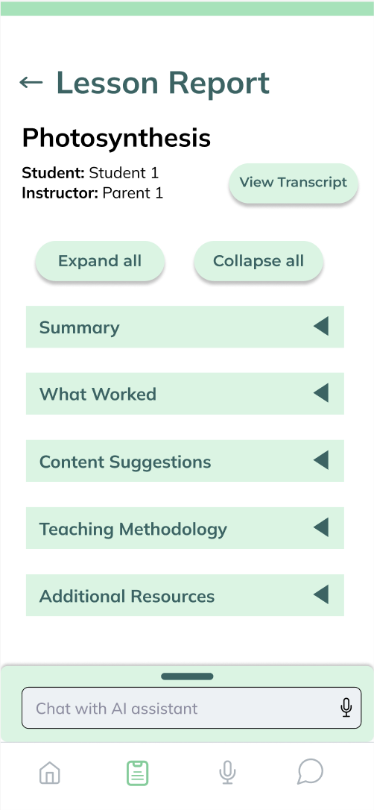
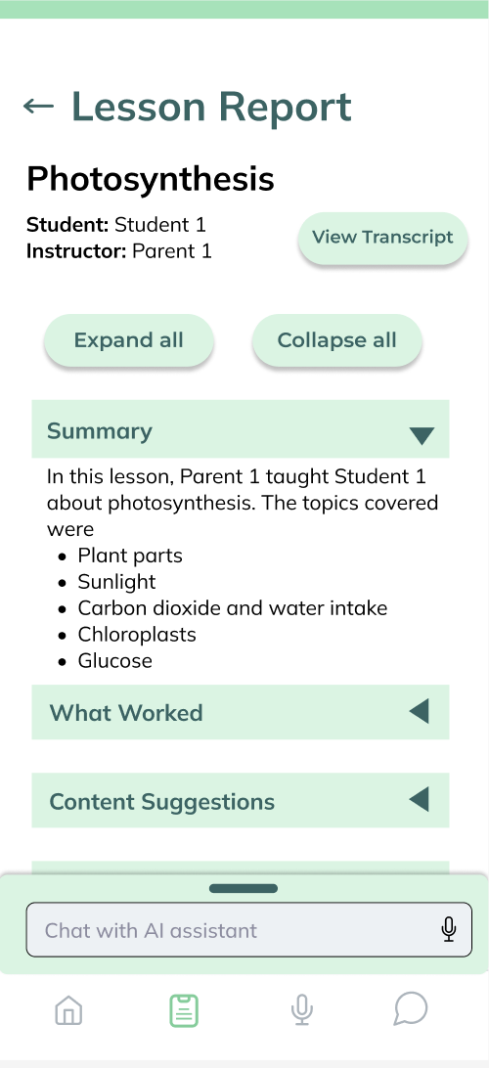
lesson report
“I do like that there are bullet points [in summary].”

Slide 36
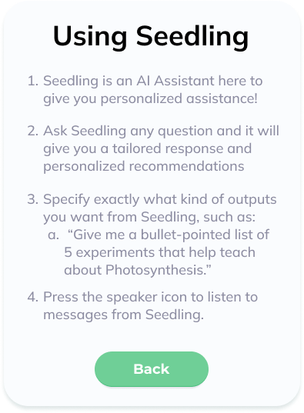
AI Assistant
“You’re providing parents with the kind of expertise they would get when sitting down with an education expert.”

Slide 37
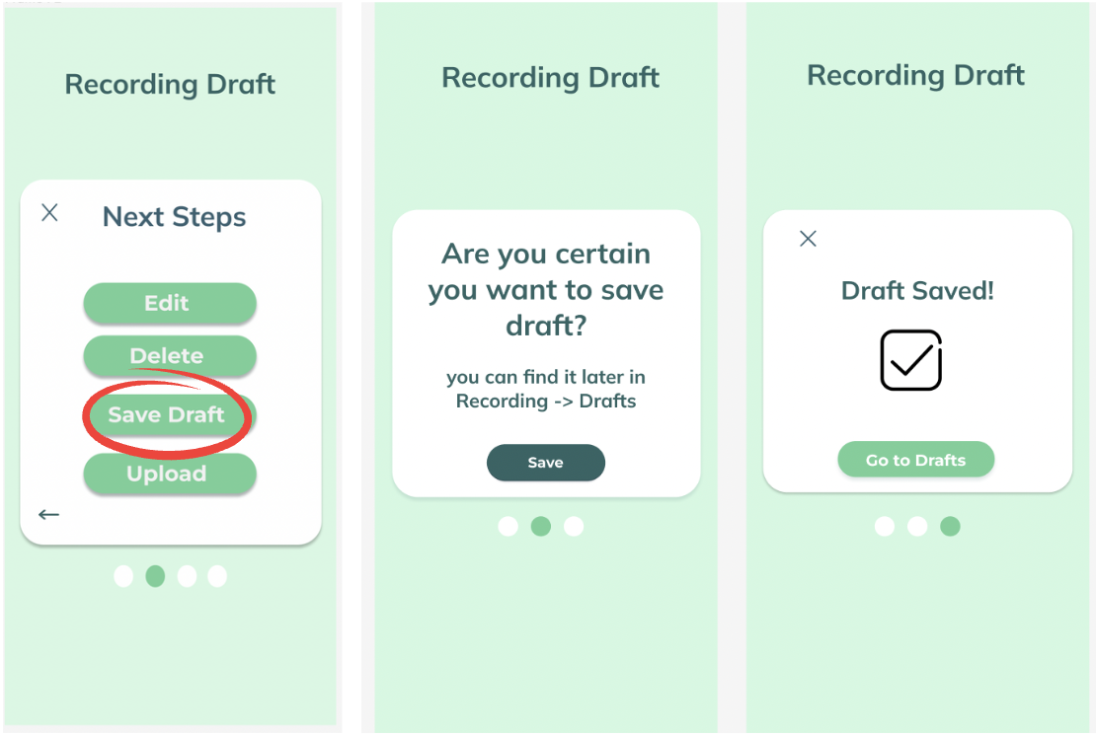
Other Changes
Iteration: user autonomy

Slide 38
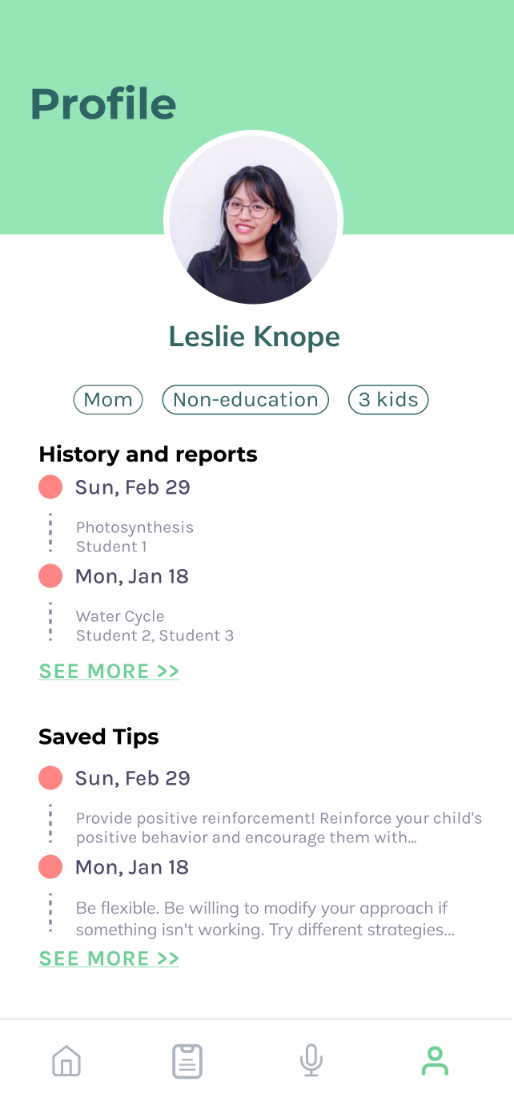
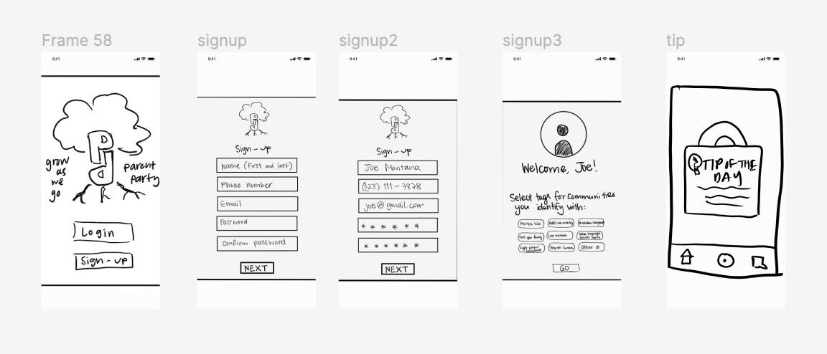
Med-fi 1 & Feedback
Navigation Bar Update
Intuitive navigation
Clear icons
Tip of the Day
Save and learn more functionality
Lesson Report
Interactive
Positive and critical feedback
No Feedback Simulation

Slide 39
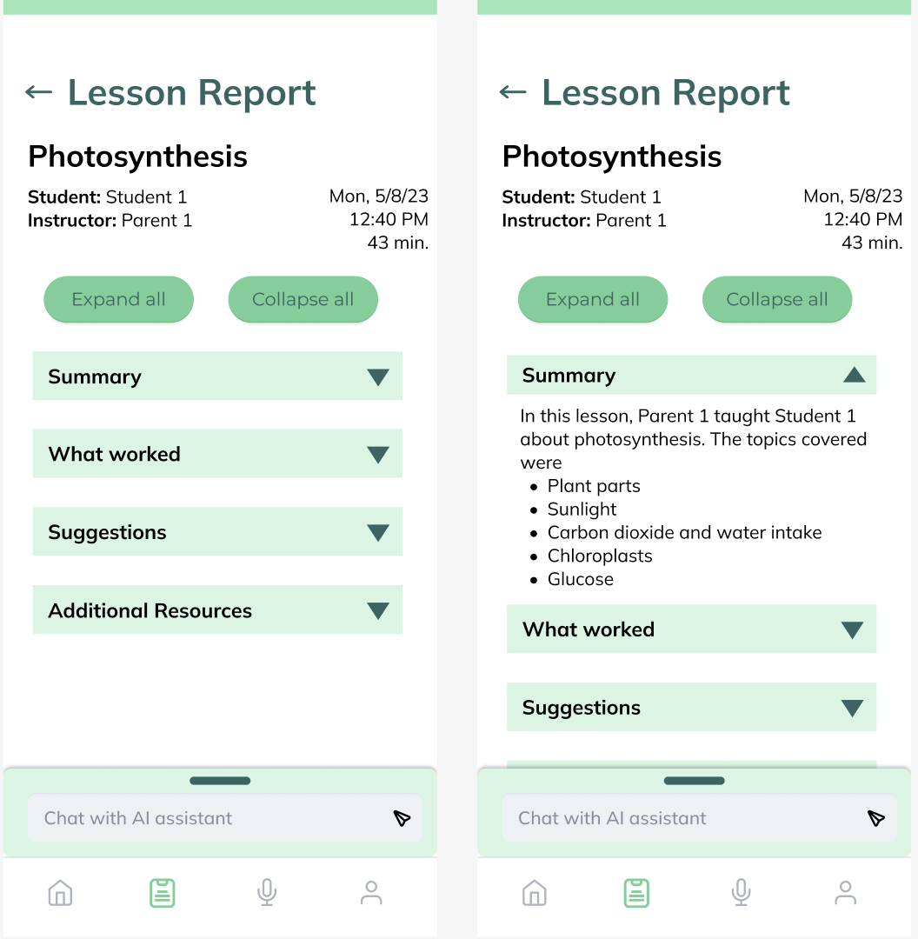
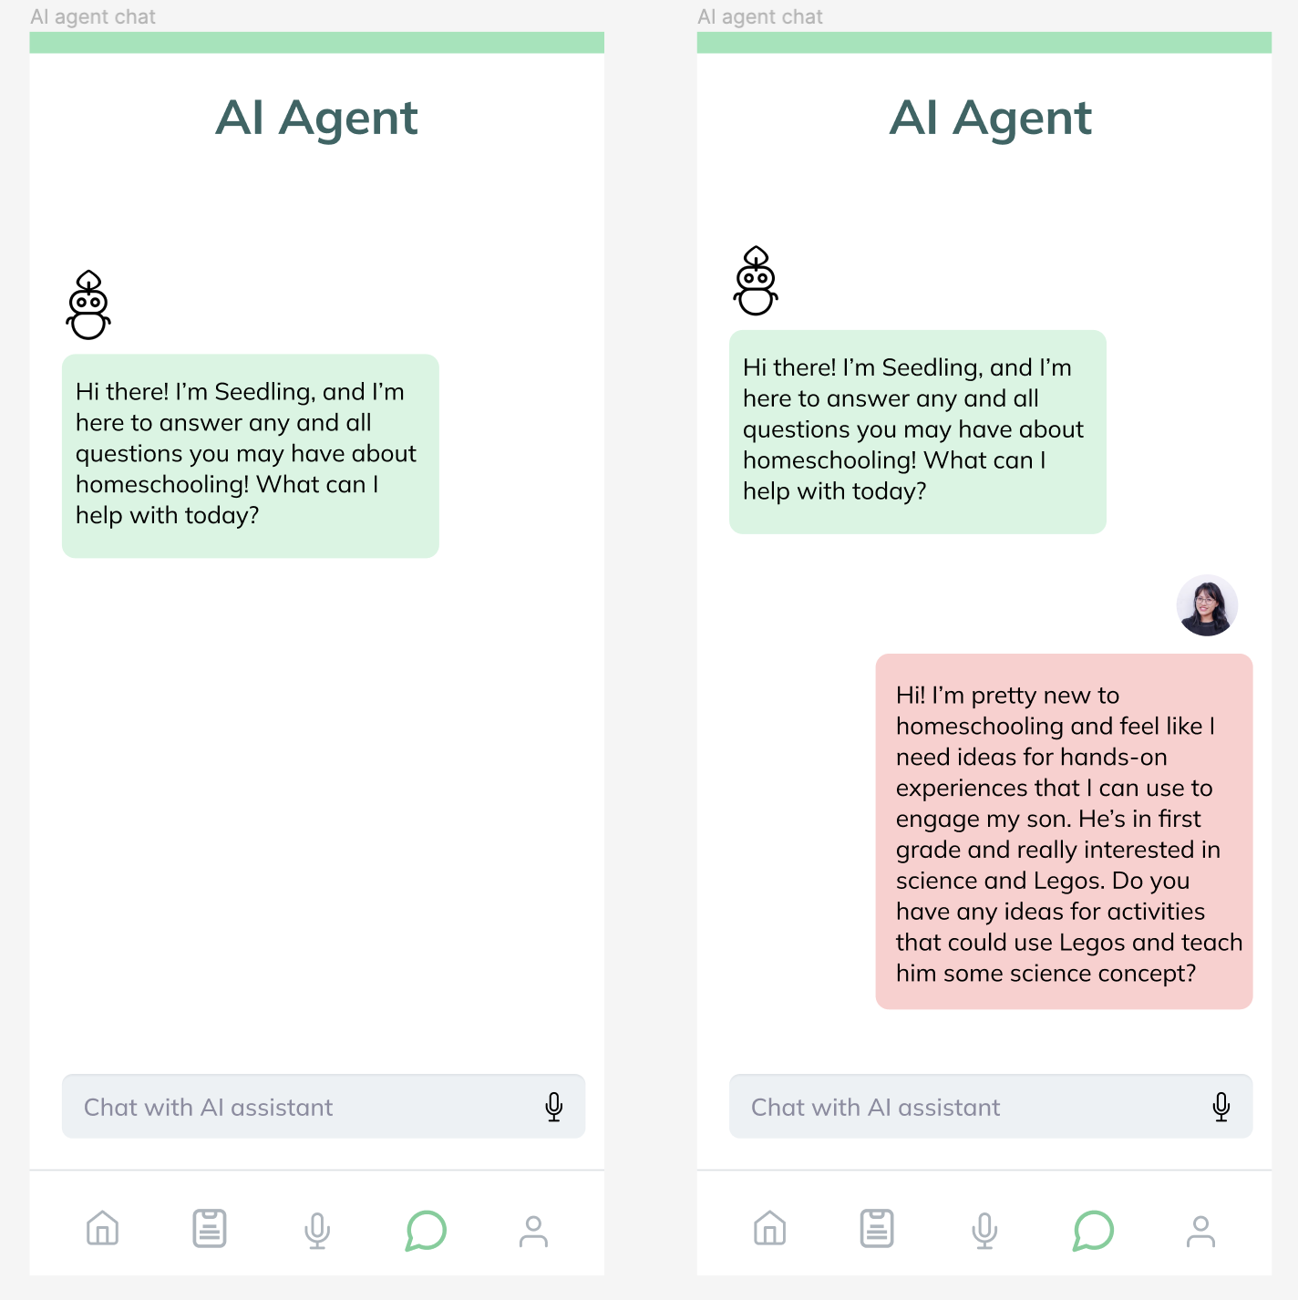
Med-fi 2
Lesson report sections
AI agent separate from report

Slide 40
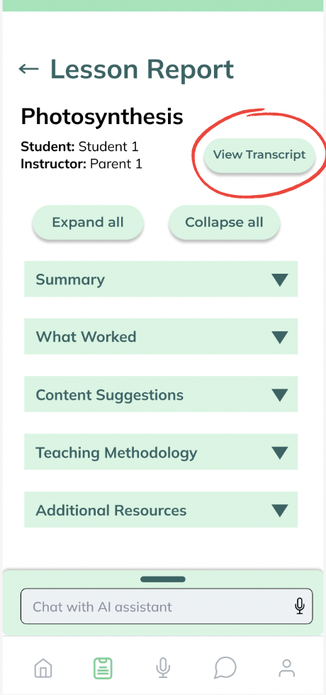
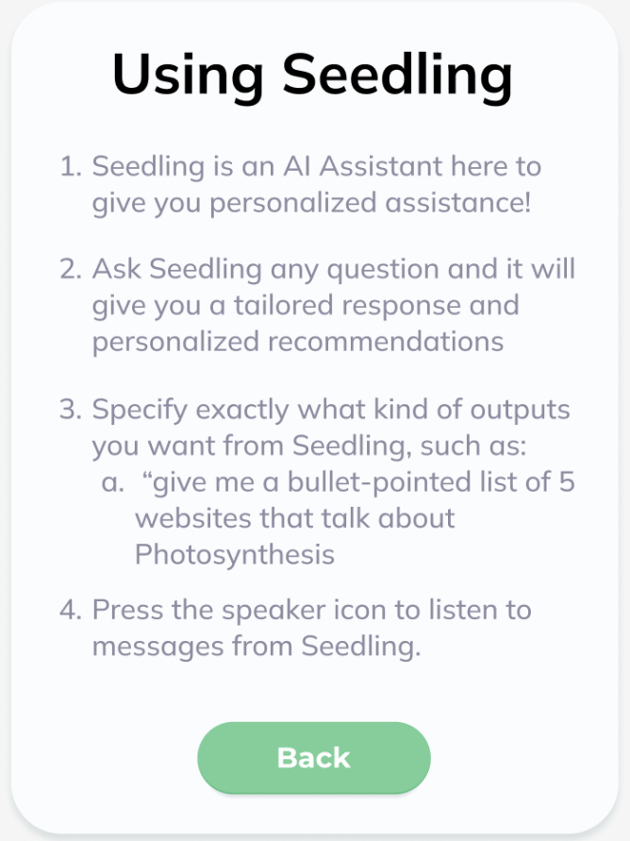
Med-fi 3 & Feedback
Saved Drafts
More user autonomy
AI Assistant Info Page
Clarify use cases
Reduce cognitive load
View Transcript Button
Access to transcripts after upload

Slide 41
Education expert in your pocket

Slide 42
outline
Intro
Intro our team
Go into story
Angela, mother of 4, HS eldest 2, no edu background, struggled with knowing how to give feedback and wanting to improve teaching but not knowing how
Process
Once we had a need → we define problem statement
we concept sketched and chose app
Then storyboarding and low-fi sketches
Pivoted away from feedback simulator - time is key resource
Including general AI agent - access to education expertise that is often $$$
Solution
From this problem, we designed a solution: app for homeschooling parents to be an education expert in their pocket (powered by AI)
Functionality - walk thru each task
Reasoning of each task
what it does / how it works
Next steps
Summary
Contact?

Slide 43
Introduction
Project title & team (introduce yourselves) [1 slide]
Title your pitch as the opportunity rather than just the title of the project
An anecdote to hook them in (tell a story from needfinding about a real person)
Outline (briefly tell us what you are going to tell us in the rest of the talk – tell a story)
brief Problem overview (Problem, existing solutions & why inadequate)
brief Solution overview (Solution, user interface, implementation)
How is AI incorporated?
How does this problem create educational inequities?
Problem
Problem
Introduction to the overall problem (great place for a story, describe needfinding) (w/ images)
Your final POV-statement
Our Solution
Solution [1 slide]
Brief mission statement or value proposition
High-level solution description (w/ image of design)
Design Evolution [multiple slides]
Show major steps (including, sketches, prototypes, etc.)
Explain key reasoning/evidence behind design changes (i.e., evaluation technique & 1-2 key findings that lead to a design change)
User Interface
Tasks & Interface Description [multiple slides for each task]
Explain the reasoning behind the choice of each of the tasks
Present walkthrough of each task
Explain what it does & how it works
Should include a live 1 to 3-minute demo or video (video backup good idea)
Integrate with tasks if it makes more sense for you
Next steps [1 slide]
If you were continuing this project, what would the next steps be?
What resources and partnerships are required to succeed?
Summary
What is your key innovation?
What will your key immediate impact on the world be?
What will be the long-term impact of your product?
Contact information (optional)
Include team members’ contact info if you want visitors to connect with you
ex) LinkedIn, email, etc

Slide 44
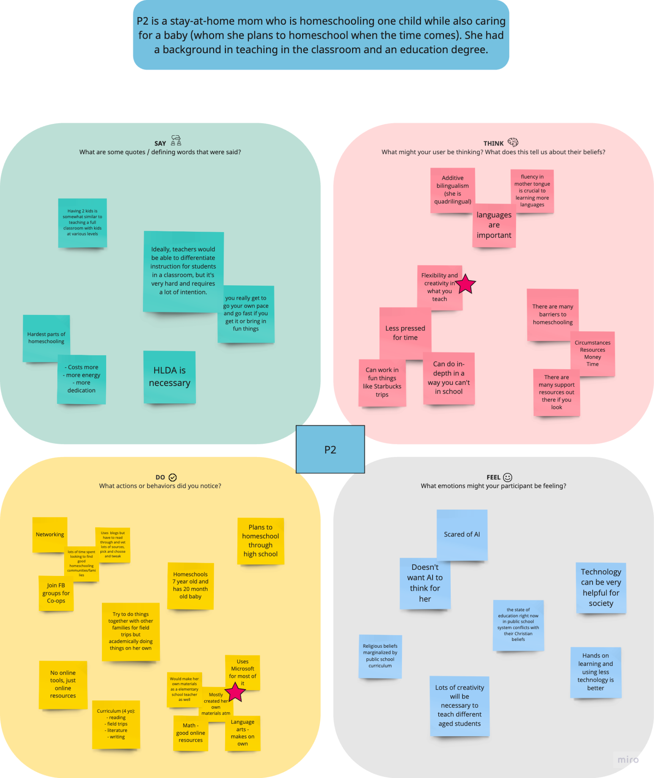
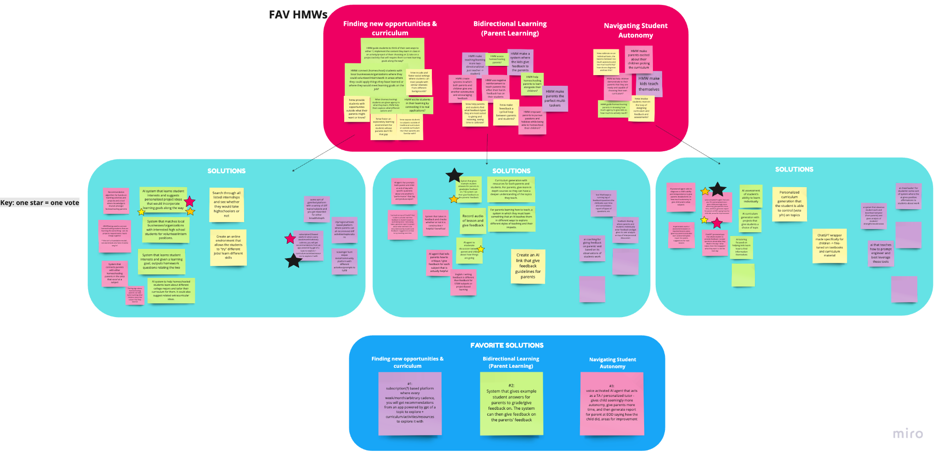
post-interview redux

Slide 45
Med-fi Prototype & Learnings
Time is a key resource:
no time for the simulation
Privacy concerns:
ability to edit input before sending
AI is non-threatening:
no pressure of judgment
Student feedback matters:
include them in the process
Proxy for expensive teaching programs:
accessible resources
Notes:
Biggest takeaways (read the screen)
From these findings, we:
Deeper with live lesson feedback
Got rid of feedback simulator

Slide 46
tip of the day
“I want to learn more about the tip of day” - Med-Fi 1 Participant

Slide 47
POV
We met…
We were
surprised to realize…
We wonder if this means…
It would be game-changing to…
she feels like homeschooling is a system that can serve both her and her children at the same time
empower parents to be able to have the flexibility and time to work while homeschooling.
a mother of four who is currently homeschooling her two eldest daughters. She was a nurse before becoming a stay-at-home mother.
that she sees the public school system as an artificial setting that exists to serve parents (their schedules, careers) and not children.

Slide 48
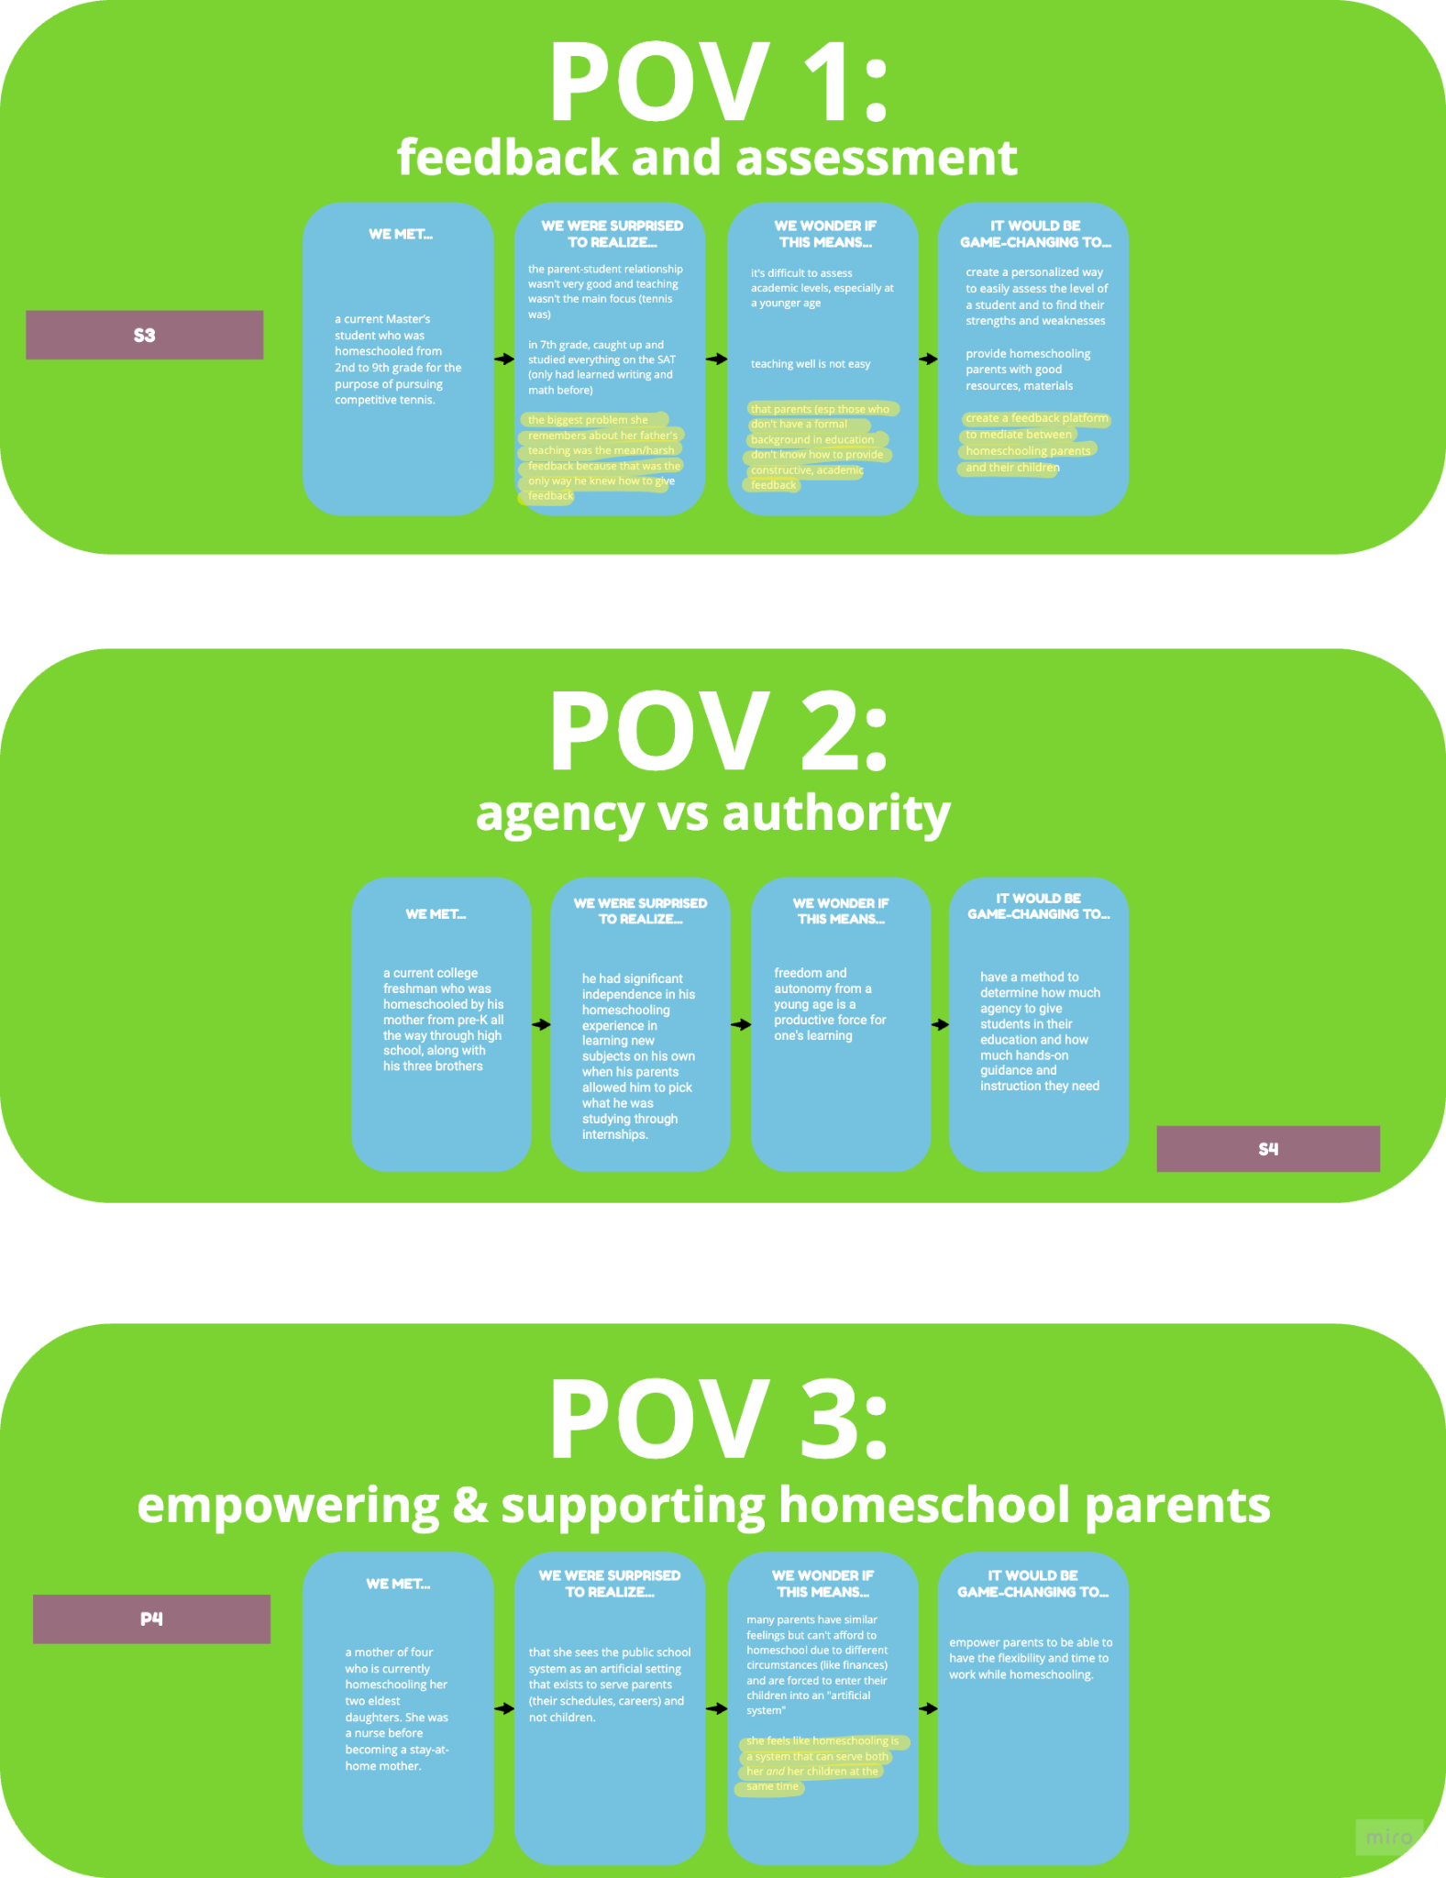

Slide 50
problem
inspiration, needfinding

Slide 51
solution
design evolution, user interface, next steps

Slide 52
design change redux (med, heuristics)

Slide 53
design change redux (med, heuristics)

Slide 54
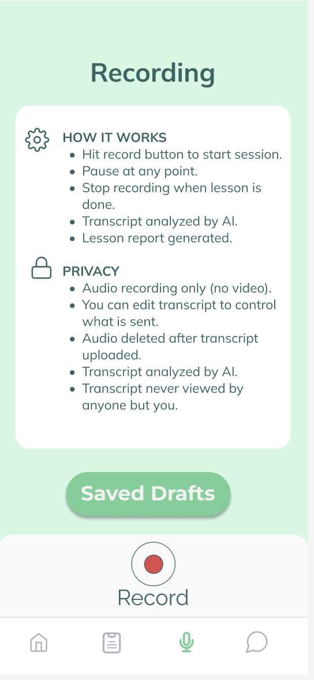
record lesson

Slide 55
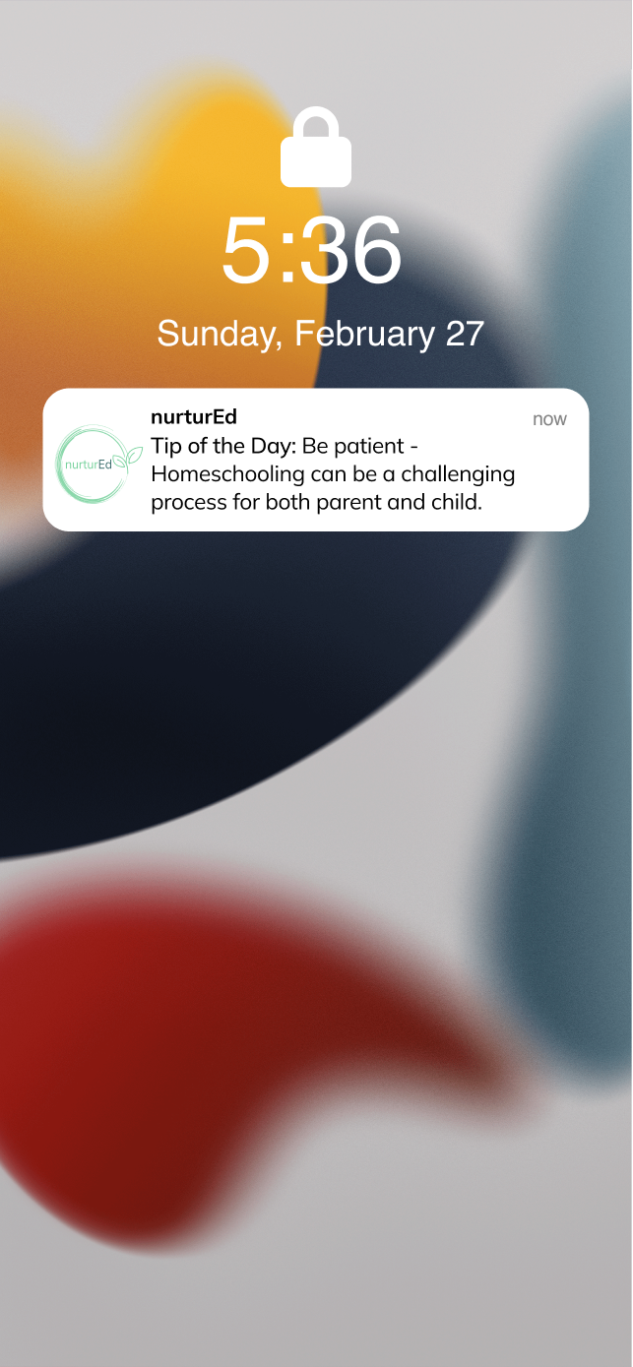
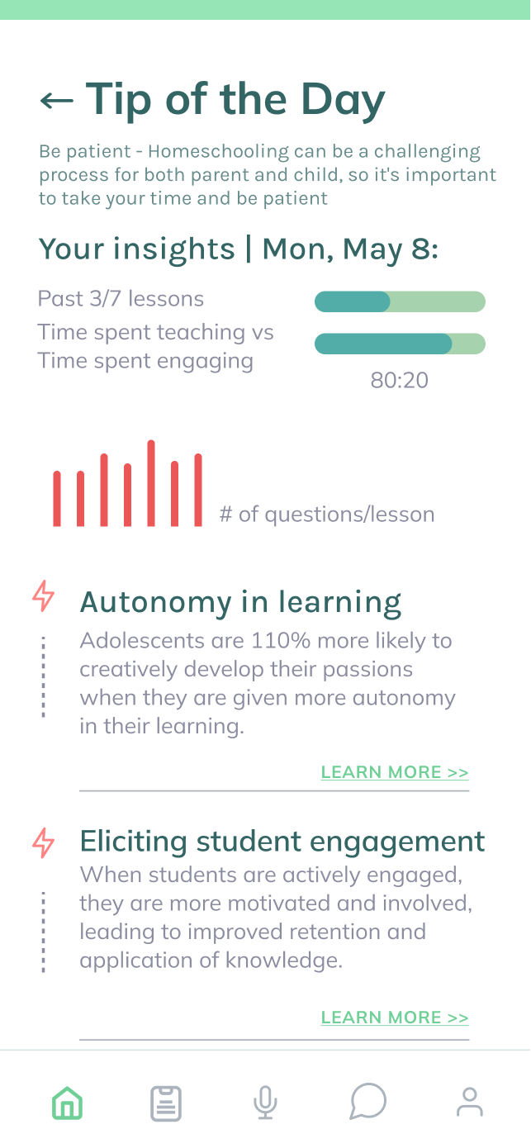




tip of the day
“I want to learn more about the tip of day” - Med-Fi 1 Participant

Slide 56
tip of the day

Slide 57
tip of the day
“I want to learn more about the tip of day” - Med-Fi 1 Participant

Slide 58
record lesson

Slide 59
record lesson

Slide 60


lesson report

Slide 61


AI assistant
“You’re providing parents with the kind of expertise they would get when sitting down with an education expert.” - Med-fi 2 Participant

Slide 62
demo

Slide 63
reflection
roadmap + summary of impact

Slide 64

Motivation to Homeschool
Methods of Teaching
insights
Peers & Community
Agency vs Authority
“The right amount of boredom is the breeding ground for creativity, but too much boredom is the breeding ground for trouble." – P1
“Parents say: you’re my kid. I know what’s best for you. But they forget that the kid needs to have some agency in the process as well.” – S3
“Public schools are in place to serve parents’ lifestyles. But I don’t think that’s a natural way to function as a child. It’s an artificial setting.” – P4

Slide 65
themes of change
Interface “Tone”
User Autonomy

